Slide 1
DAMRO Dive into Attention Mechanism of LVLM to Reduce Object Hallucination
Paper Submitted

Slide 2
Paper Submitted
1
Introduction & Related Work
2
Motivation & Method
3
Experiments Details
Notes:
我们会从
多模态大模型模型幻觉
提出的 MARINE 模型架构
复现细节

Slide 3
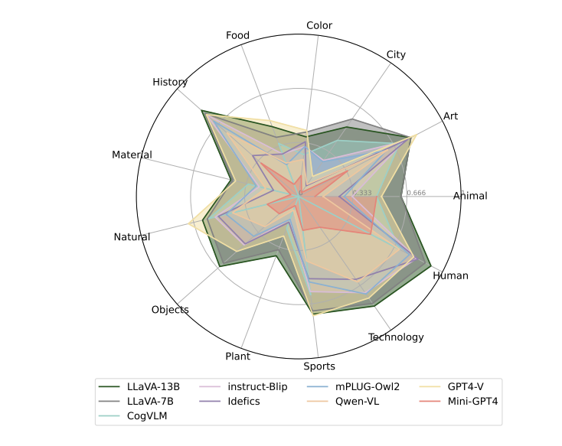
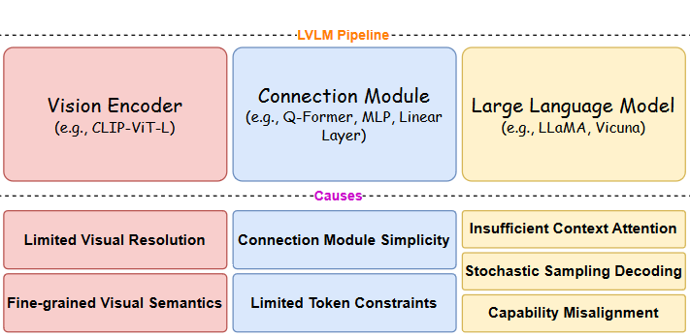
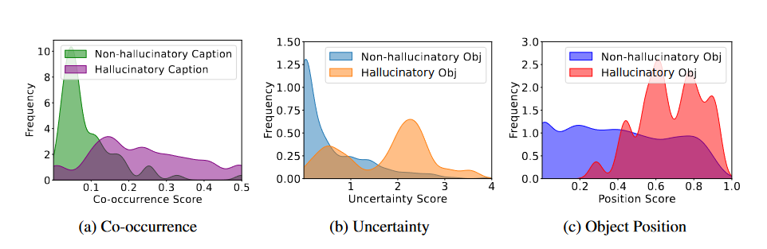
Related Work
LVLM Hallucinations
Structural Reasons
Visual Encoder
Projection Module
LLM
Data Bias
Reasons of Input and Output
Co-occurrence
Uncertainty
Position Score
Fig 1. Structural reasons [1]
Fig 2. Data bias [2]
Fig 3. Influence of co-occurrence, uncertainty, position score on hallucinations [3]
[1] Liu, Hanchao, et al. "A survey on hallucination in large vision-language models." arXiv preprint arXiv:2402.00253 (2024).
[2] Han, Tianyang, et al. "The Instinctive Bias: Spurious Images lead to Hallucination in MLLMs." arXiv preprint arXiv:2402.03757 (2024).
[3] Zhou, Yiyang, et al. "Analyzing and mitigating object hallucination in large vision-language models." arXiv preprint arXiv:2310.00754 (2023)
Notes:
通常来说多模态大模型LVLM的结构可以分为三部分：
1. 视觉编码器
2. 模态融合/ 投影层
3. 大模型解码器，用于生成目标模态
导致多模态大模型幻觉的原因
视觉编码器：视觉信息提取不足
视觉与语言对齐方式：对齐方式有缺陷
大语言模型解码器：继承预训练数据的数据特征，引入新幻觉
右边展示了一个幻觉的例子，LLaVA LURE的结果都生成了图中并不存在的事物

Slide 4
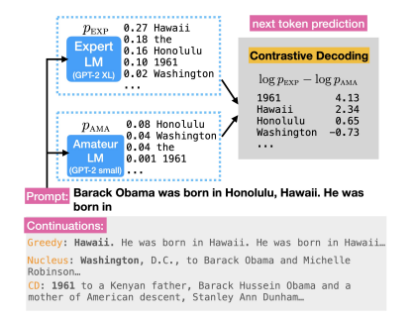
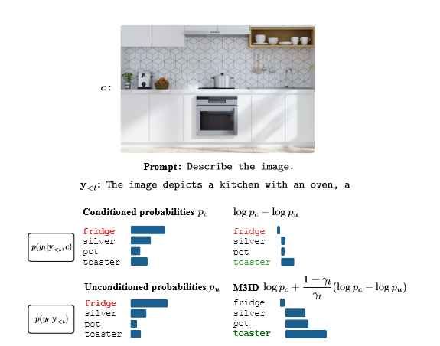
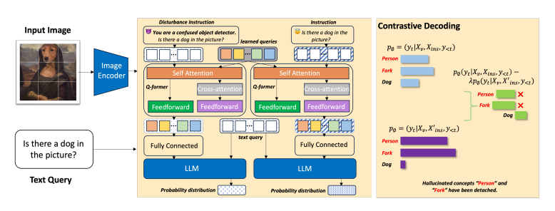
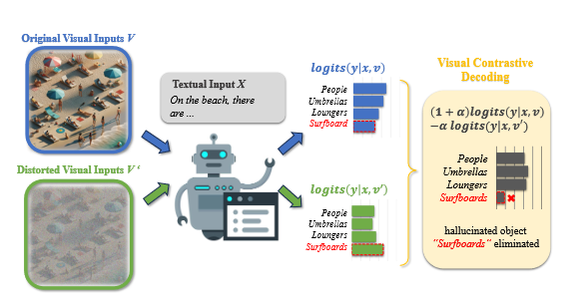
Related Work
Contrastive Decoding
Contrastive Decoding for LLM
Expert & Amateur LM
Reduce noise by subtracting the distribution of an amateur model
Contrastive Decoding to Mitigate Hallucination
Eliminate the influence of LLM prior
Subtract the distribution of the distribution of negative sample
Fig 4. Contrastive Decoding for LLM[1]
Fig 5. Contrastive Decoding to Mitigate Hallucination[2,3,4]
[1] Li, Xiang Lisa, et al. "Contrastive decoding: Open-ended text generation as optimization." arXiv preprint arXiv:2210.15097 (2022).
[2] Favero, Alessandro, et al. "Multi-modal hallucination control by visual information grounding." Proceedings of the IEEE/CVF Conference on Computer Vision and Pattern Recognition. 2024.
[3] Wang, Xintong, et al. "Mitigating hallucinations in large vision-language models with instruction contrastive decoding." arXiv preprint arXiv:2403.18715 (2024).
[4] Leng, Sicong, et al. "Mitigating object hallucinations in large vision-language models through visual contrastive decoding." Proceedings of the IEEE/CVF Conference on Computer Vision and Pattern Recognition. 2024.
Notes:
之前尝试的解决多模态大模型幻觉的方法主要分为两类：
第一种是从数据层面解决：选用更高质量的训练集做微调
但是这样会有很大的人力和计算资源的消耗，如果高质量训练集比较少同时会有过拟合的风险
第二种是后处理的方式解决，在结果产生之后，引入其他大模型作为矫正者，如添加prompt说：矫正这张图片的幻觉的方法来队结果进行处理
但是这样相当于对原 prompt 产生了污染，同时也会引入矫正者模型的幻觉

Slide 5
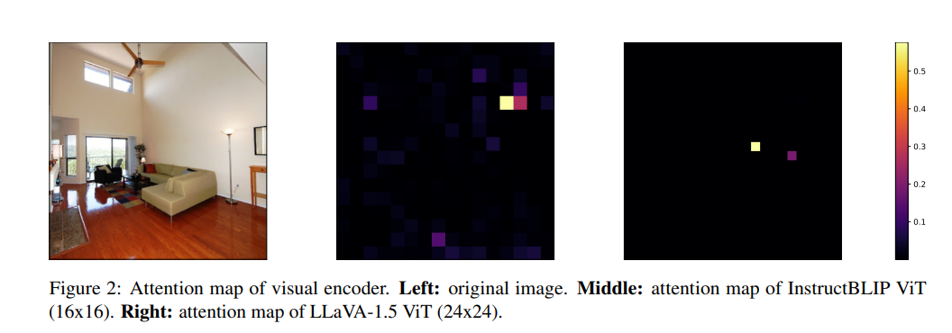
Motivation
Drawbacks of ViT
The attention maps of LVLMs’ visual encoder also focus on a small number of high-norm outlier tokens
Validate the information contained within these tokens as perceived by the LLM
Notes:
本文从
视觉信息处理
和
后处理
两个大方面
减少大模型幻觉
首先在原有模型的基础上增强视觉信息的引导作用，
用 Object Grounding Features 作为prompt 中的 soft guidance
将合并之后的prompt送入大模型解码器进行文本生成
最后的解码引入受控文本生成，进一步减轻幻觉结果

Slide 6
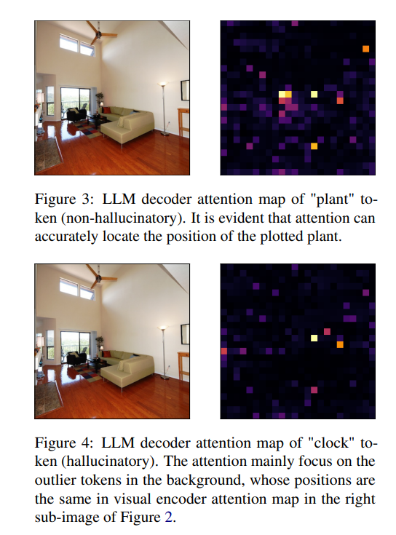
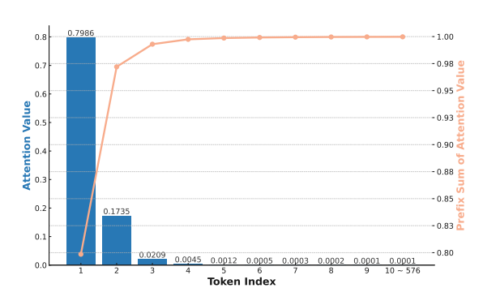
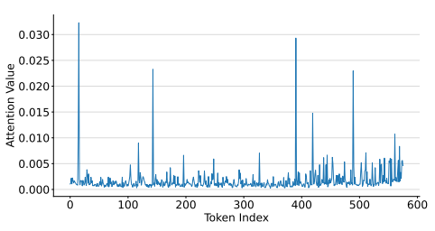
Motivation
Outlier Tokens Cause Hallucination
Case Study on Attention Map of LLM Decoder
LLM decoder pays more attention to outlier tokens identified in visual encoding stage
Distribution of Attention Values
Notes:
在文本生成部分，作者对原有大模型修改了两部分，
首先将视觉信息所提取的结果添加到生成式模型中作为输入；
其次，最后的结果由 添加与不添加视觉引导信息两种大模型生成结果 添加权重 计算得到。

Slide 7
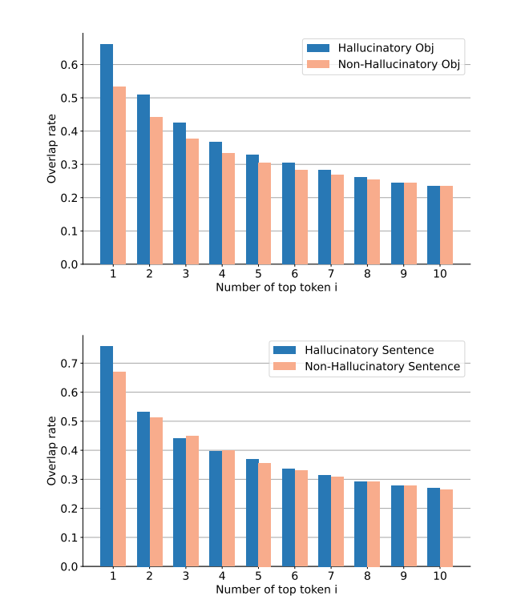
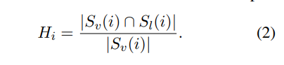
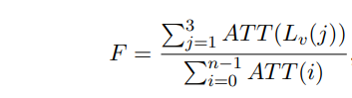
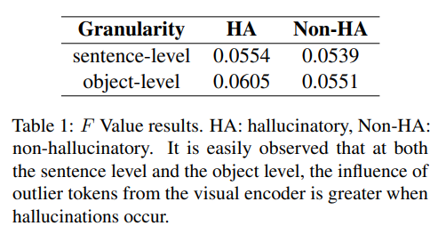
Motivation
Outlier Tokens Cause Hallucination
Verification of Our Findings
Notes:
在文本生成部分，作者对原有大模型修改了两部分，
首先将视觉信息所提取的结果添加到生成式模型中作为输入；
其次，最后的结果由 添加与不添加视觉引导信息两种大模型生成结果 添加权重 计算得到。

Slide 8
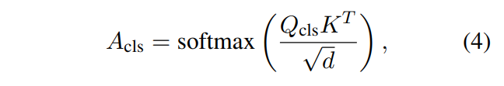
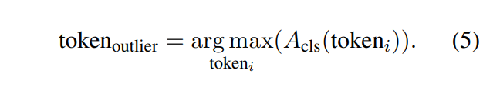
Method
Outlier Tokens Selection
Calculate the attention value of Visual Encoder
Select top k outlier tokens
Notes:
这里展示了文本生成部分，作者提出的模型对最后结果生成引导的过程，
添加视觉信息生成部分
不添加信息生成部分
最后加权得到最终结果。

Slide 9
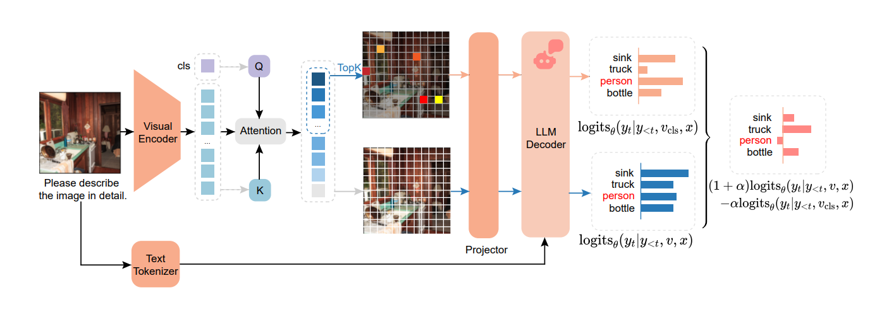
Method
Contrastive Decoding
Fig . An Overview of DAMRO Structure
Notes:
这里展示了文本生成部分，作者提出的模型对最后结果生成引导的过程，
添加视觉信息生成部分
不添加信息生成部分
最后加权得到最终结果。

Slide 10
Method
Baselines
Instruct-BLIP
VCD
M3ID
Model
Method
LLaVA-1.5
LLaVA-NeXT
Original
Leng S, Zhang H, Chen G, et al. Mitigating object hallucinations in large vision-language models through visual contrastive decoding[C]//Proceedings of the IEEE/CVF Conference on Computer Vision and Pattern Recognition. 2024: 13872-13882.
Favero A, Zancato L, Trager M, et al. Multi-modal hallucination control by visual information grounding[C]//Proceedings of the IEEE/CVF Conference on Computer Vision and Pattern Recognition. 2024: 14303-14312.
Notes:
模型

Slide 11
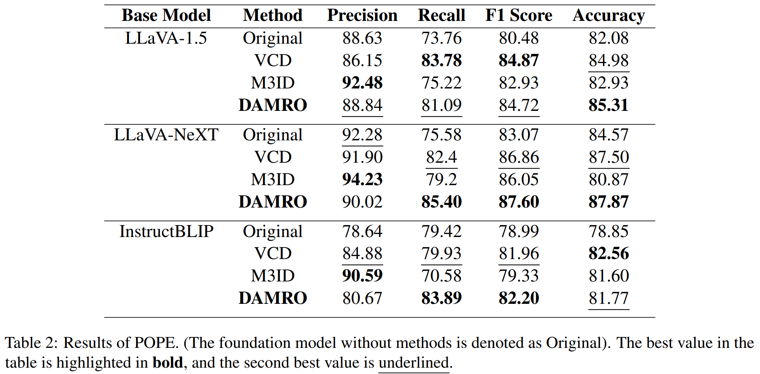
Experiments
Experiments
POPE
[Prompt]: Is there a <object> in the Image?
Please use one word to answer this question.
[Model Response]: Yes. / No.
Dataset
MSCOCO validation
500 randomly selected images
Li Y, Du Y, Zhou K, et al. Evaluating object hallucination in large vision-language models[J]. arXiv preprint arXiv:2305.10355, 2023.

Slide 12
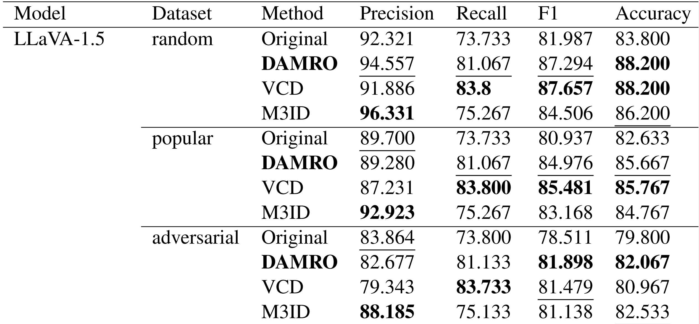
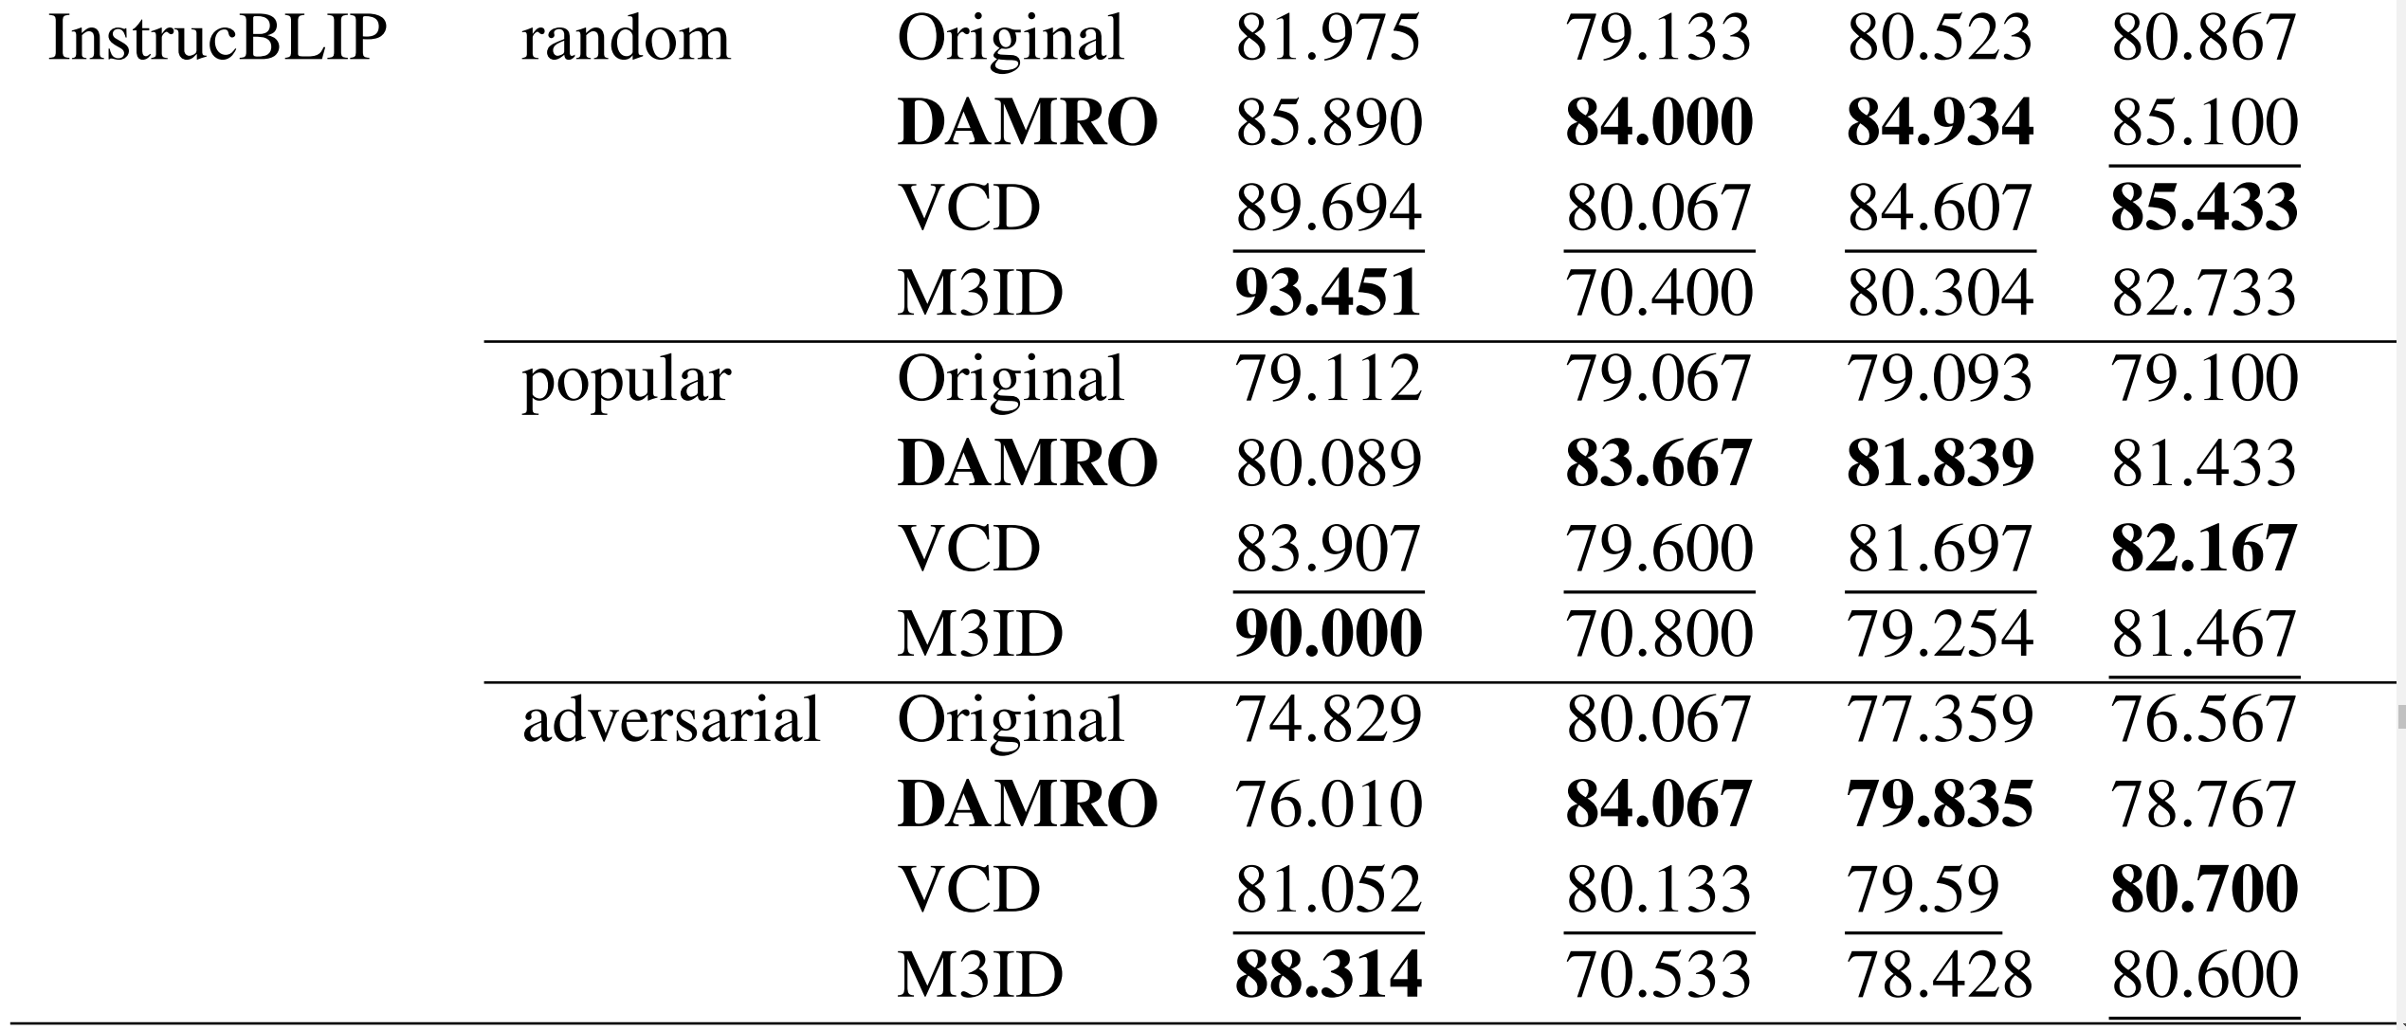
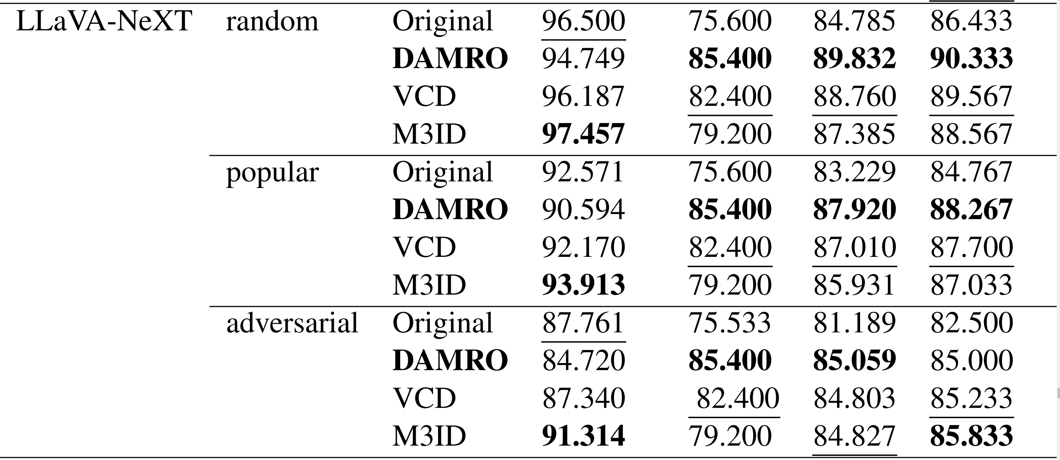
Experiments
Experiments
POPE test on 3 splits:
random & popular & adversarial
Li Y, Du Y, Zhou K, et al. Evaluating object hallucination in large vision-language models[J]. arXiv preprint arXiv:2305.10355, 2023.

Slide 13
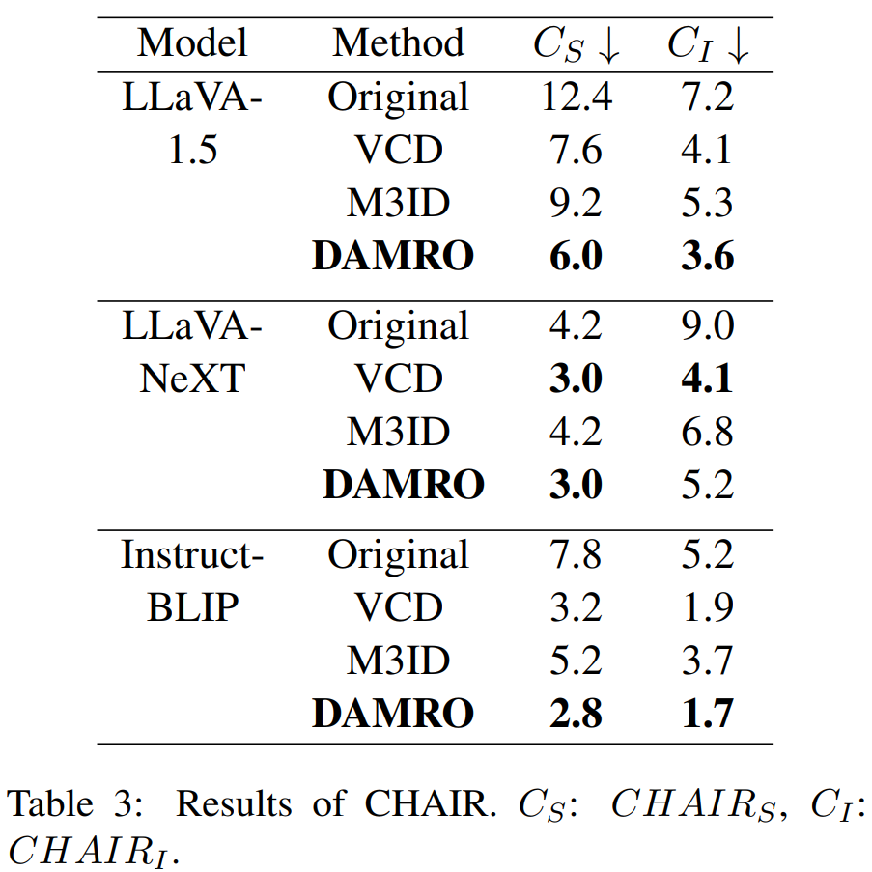
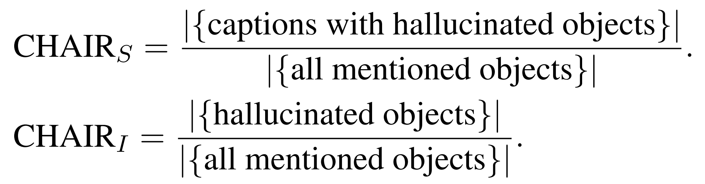
Experiments
Experiments
CHAIR
Compares the captions generated by the LVLM
with the ground truth.
Rohrbach A, Hendricks L A, Burns K, et al. Object hallucination in image captioning[J]. arXiv preprint arXiv:1809.02156, 2018.

Slide 14
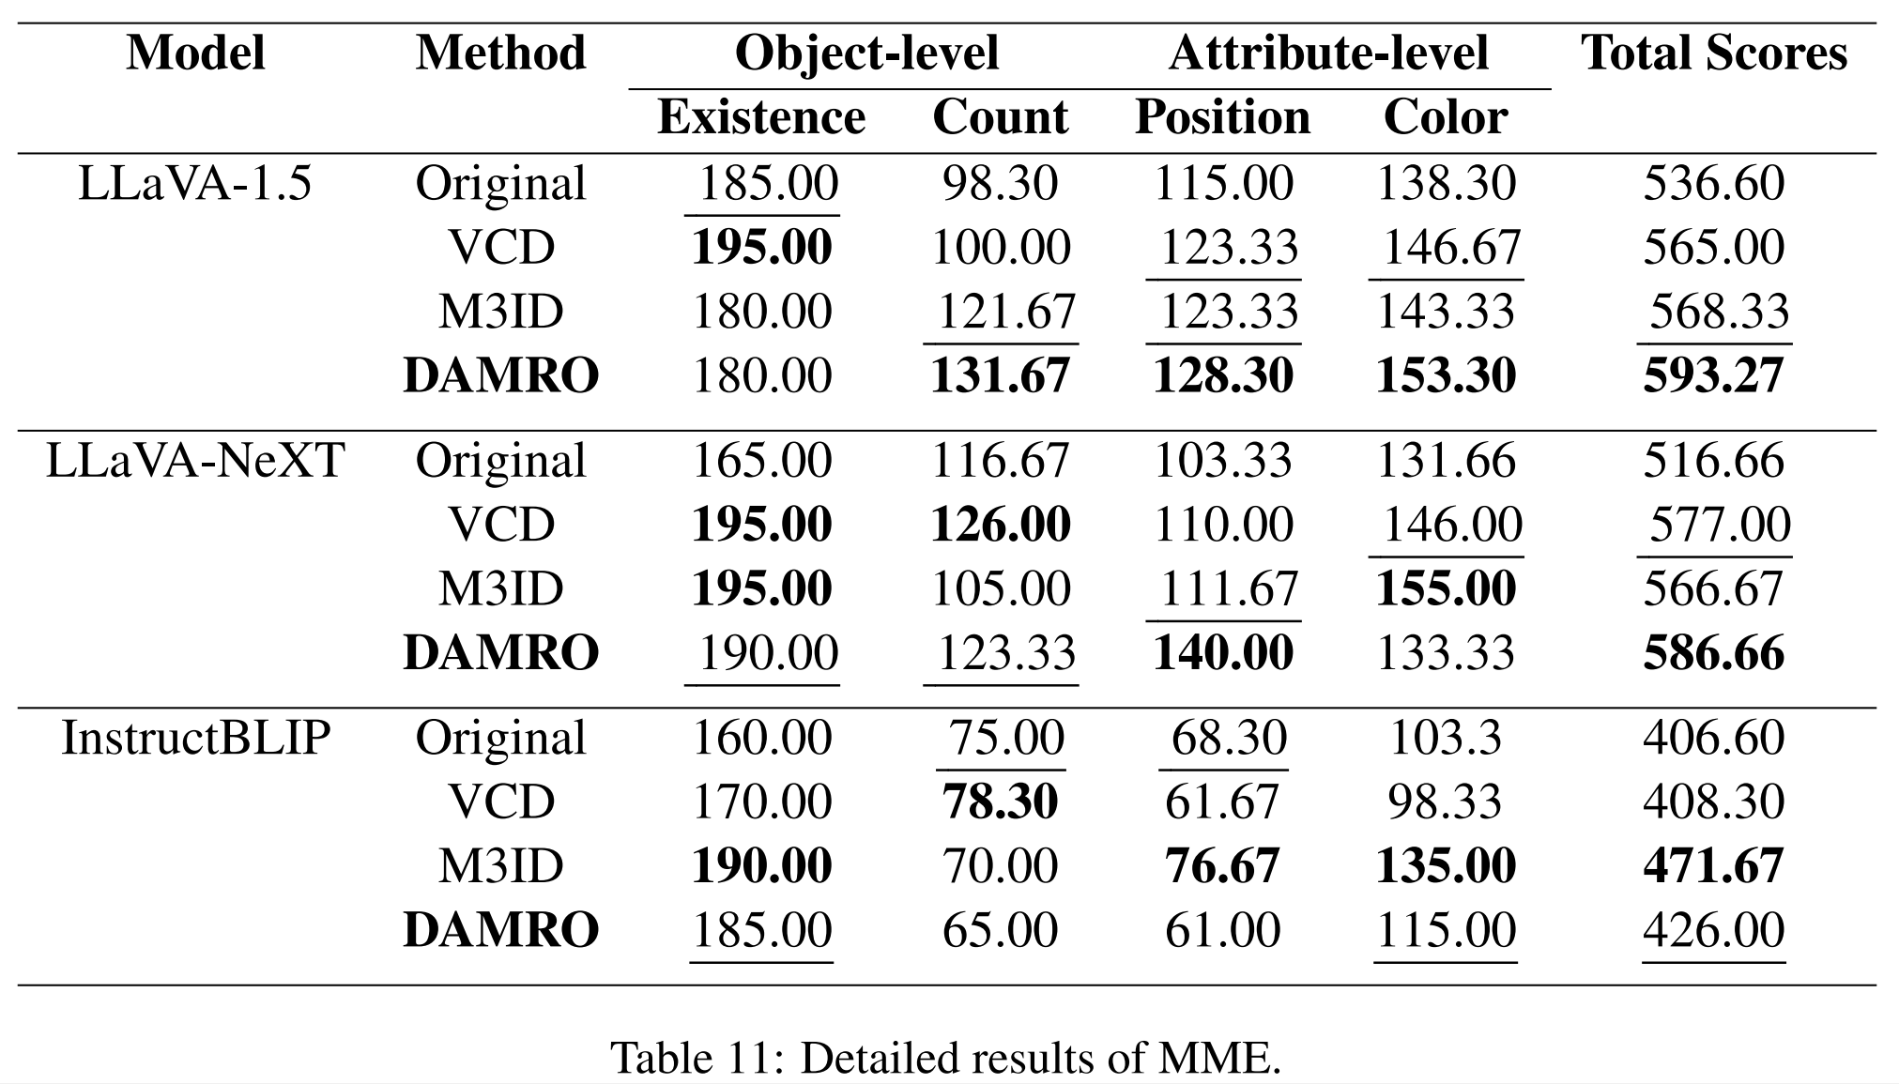
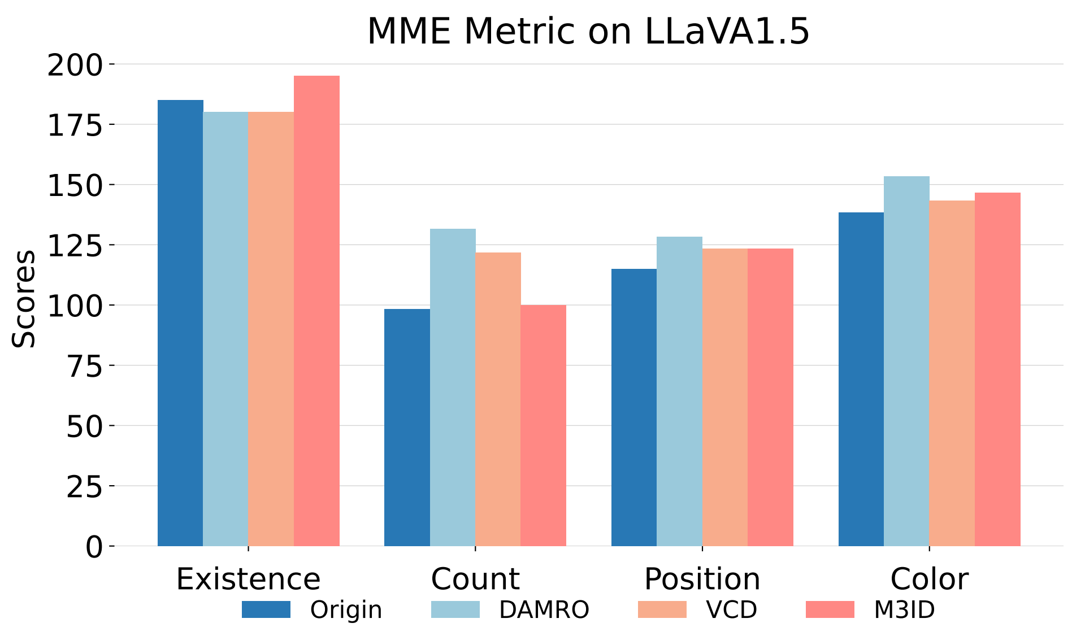
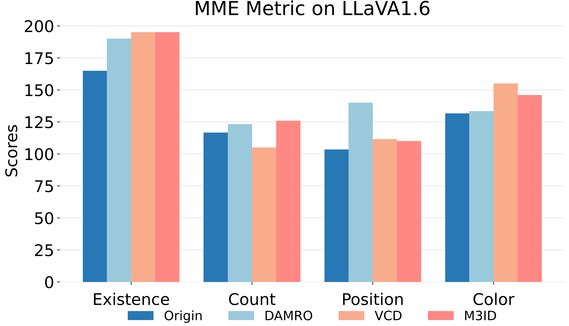
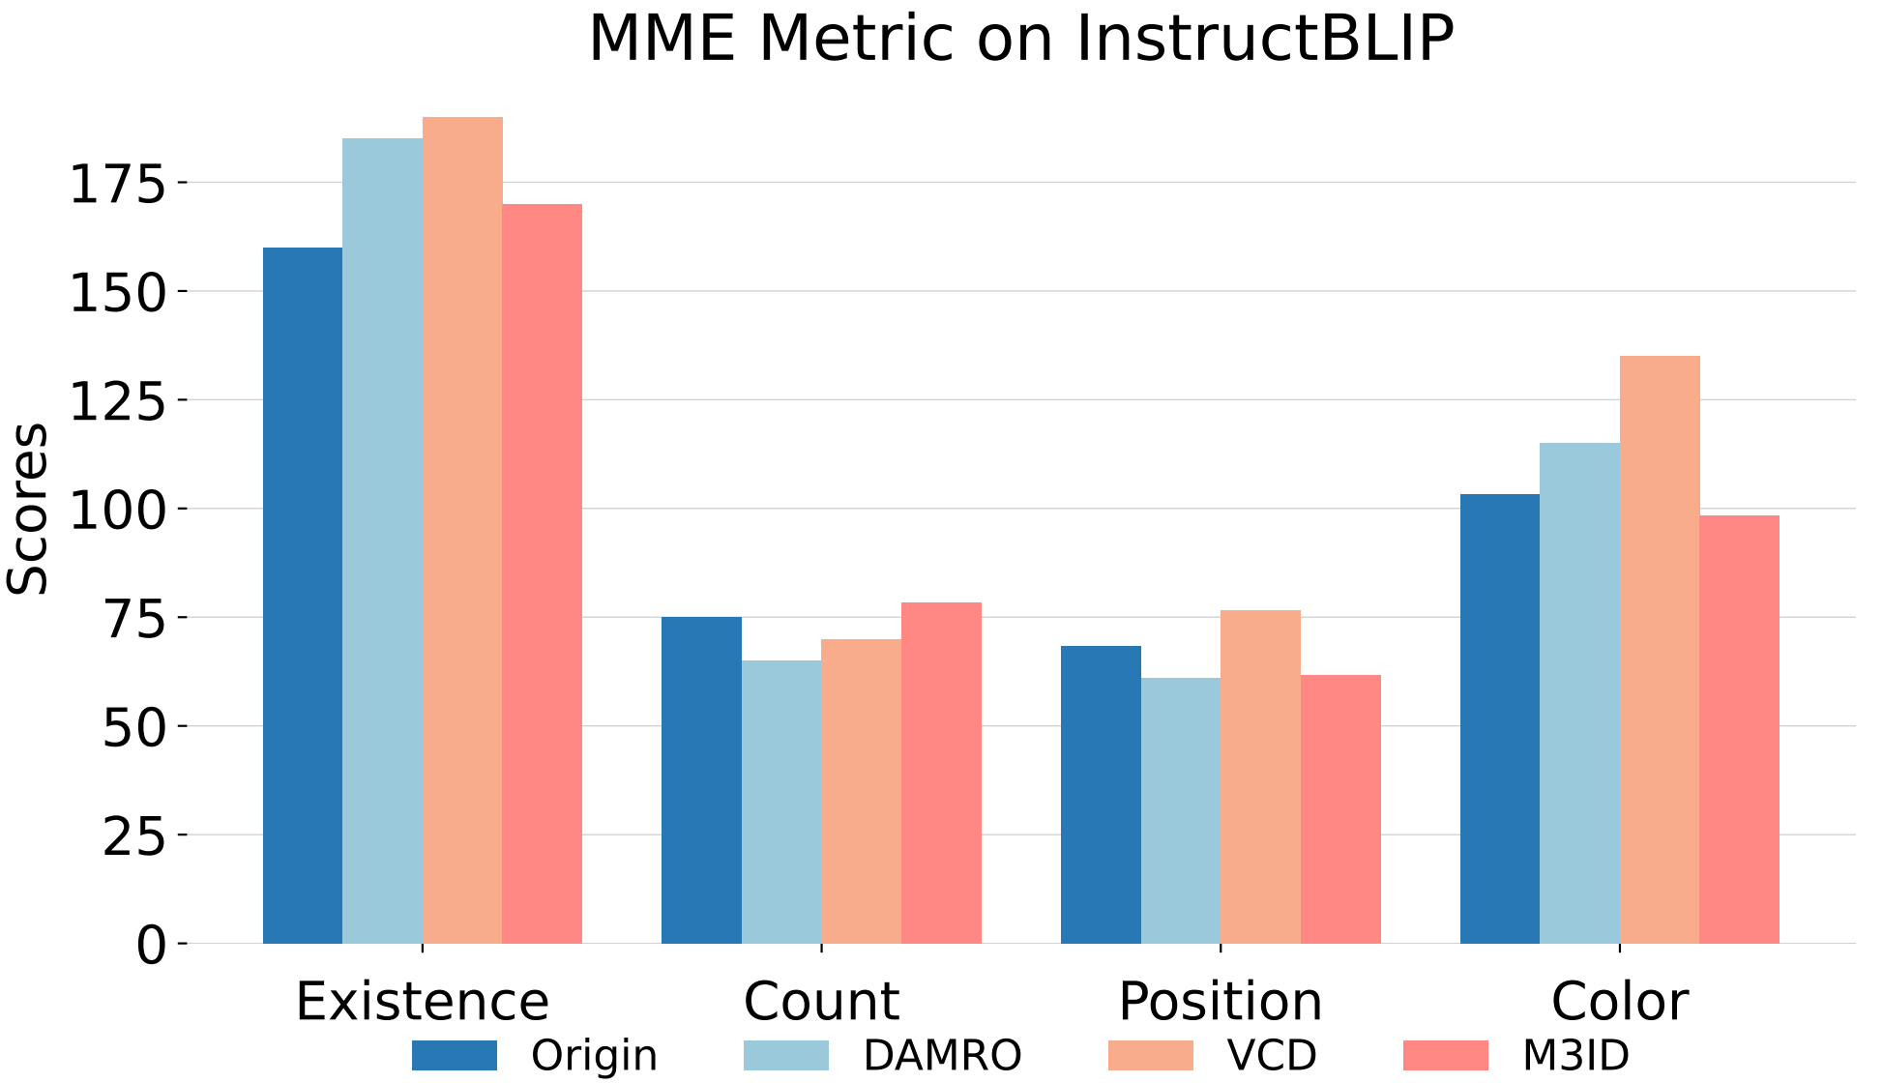
Experiments
Experiments
MME
A subset of comprehensive questions which measures both perception and cognition abilities.
We selected 4 categories: Existance, count, position and color.
Yin S, Fu C, Zhao S, et al. A survey on multimodal large language models[J]. arXiv preprint arXiv:2306.13549, 2023.

Slide 15
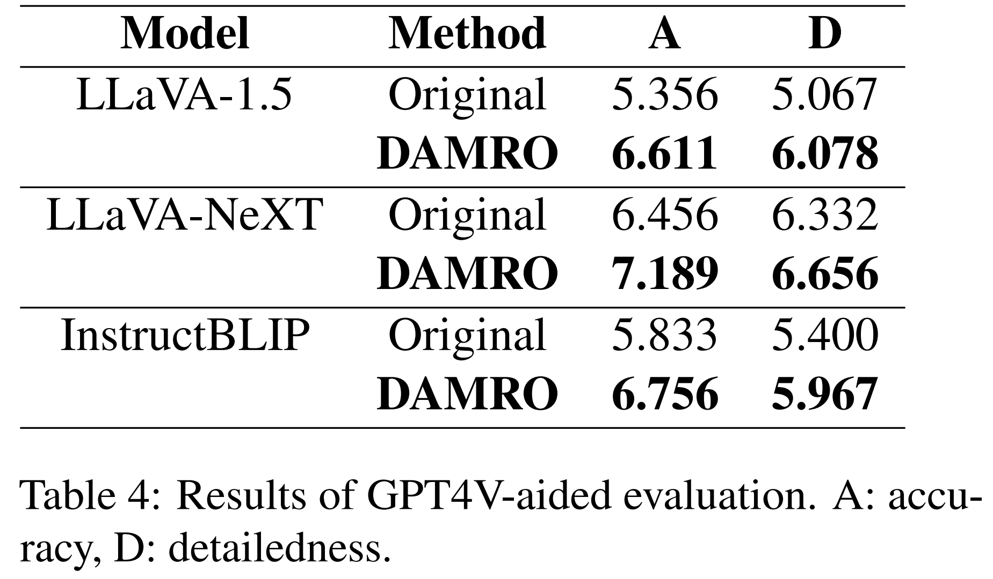
Experiments
Experiments
GPT-4V-aided Evaluation
GPT-4V as evaluator of responses from models
Accuracy & Detailedness

Slide 16
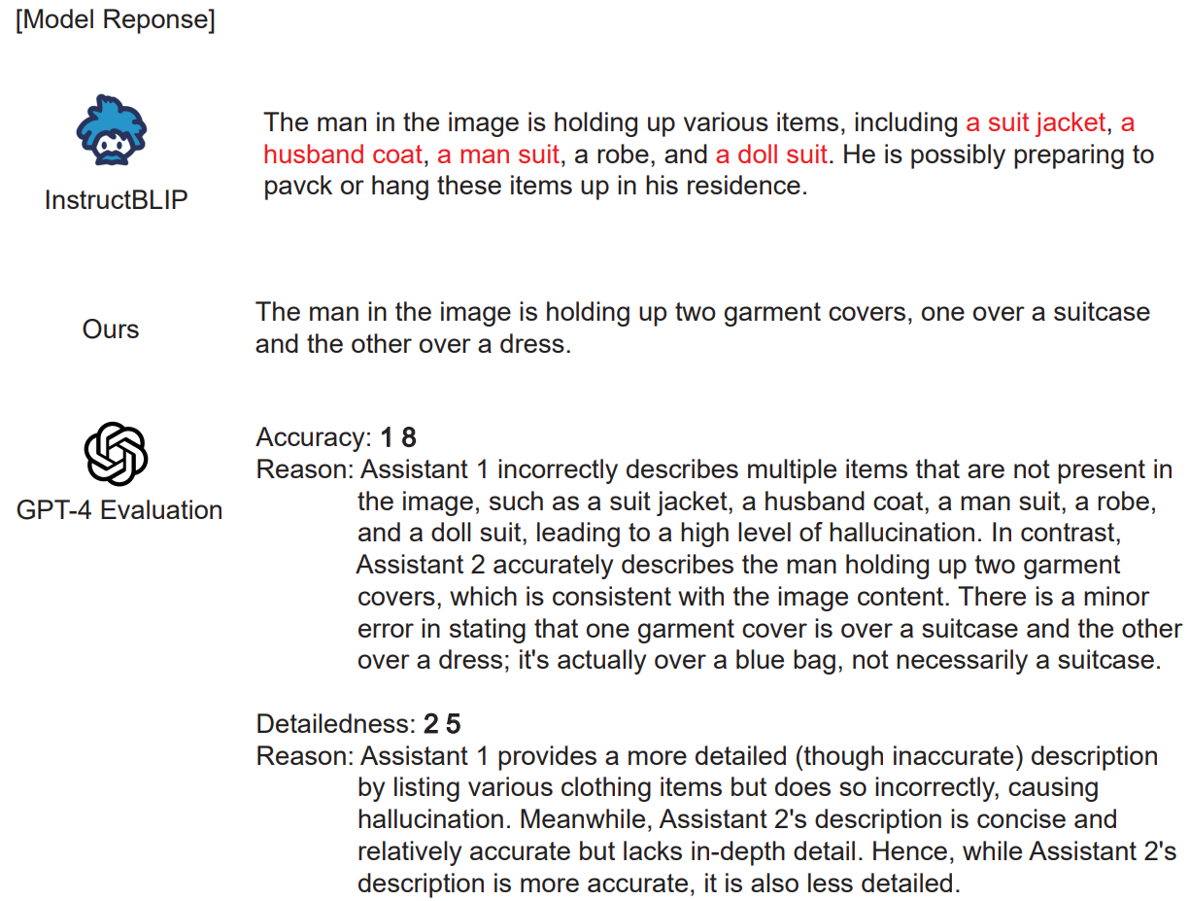
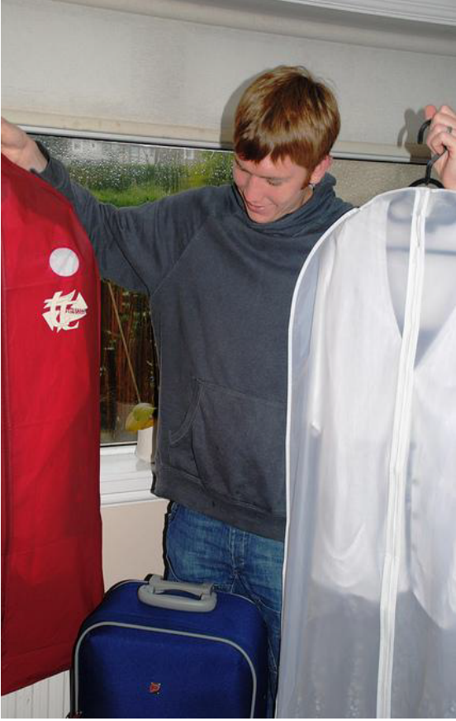
Experiments

Slide 17
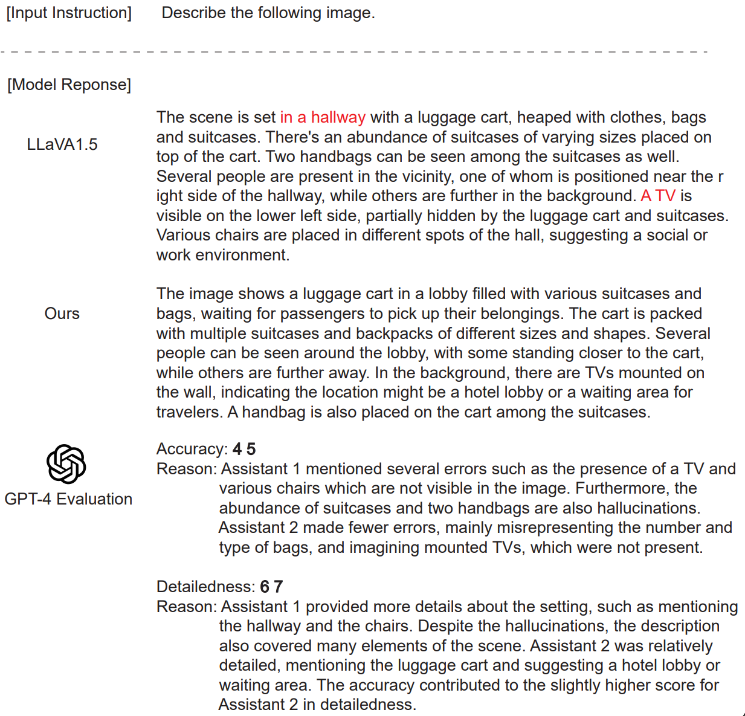

Experiments

Slide 18

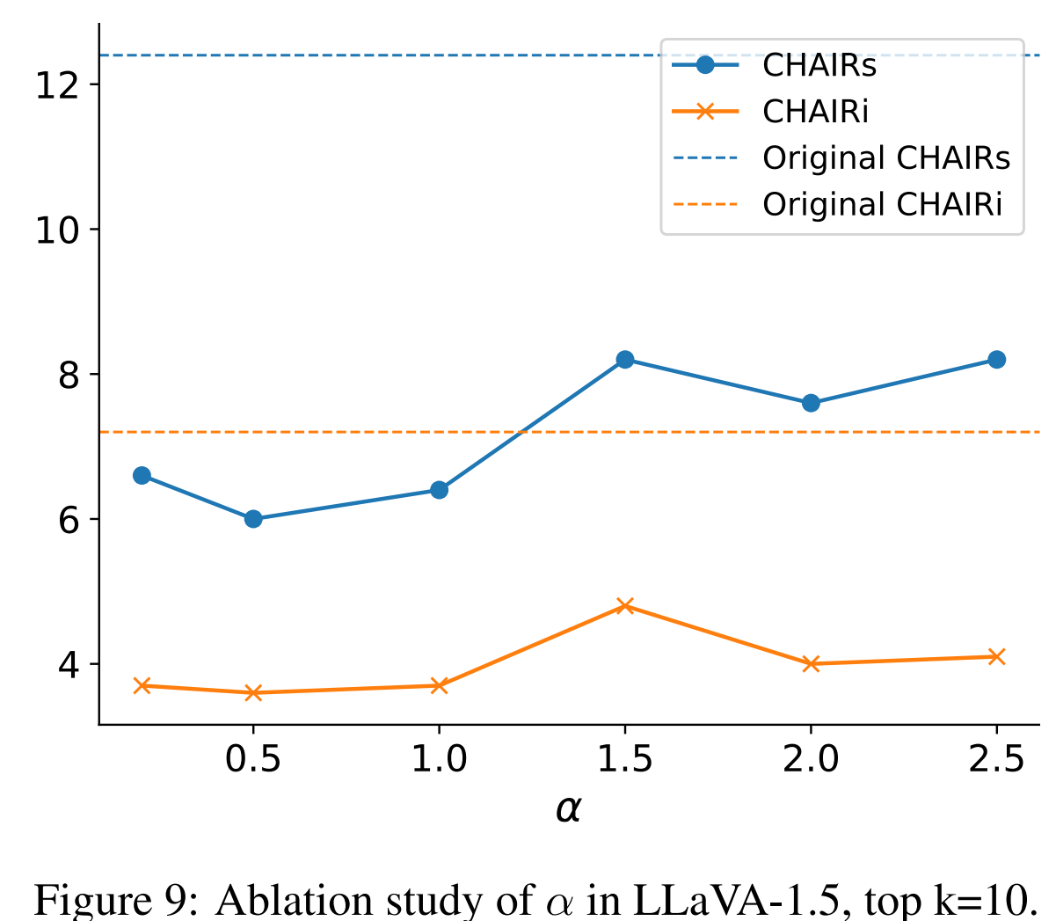
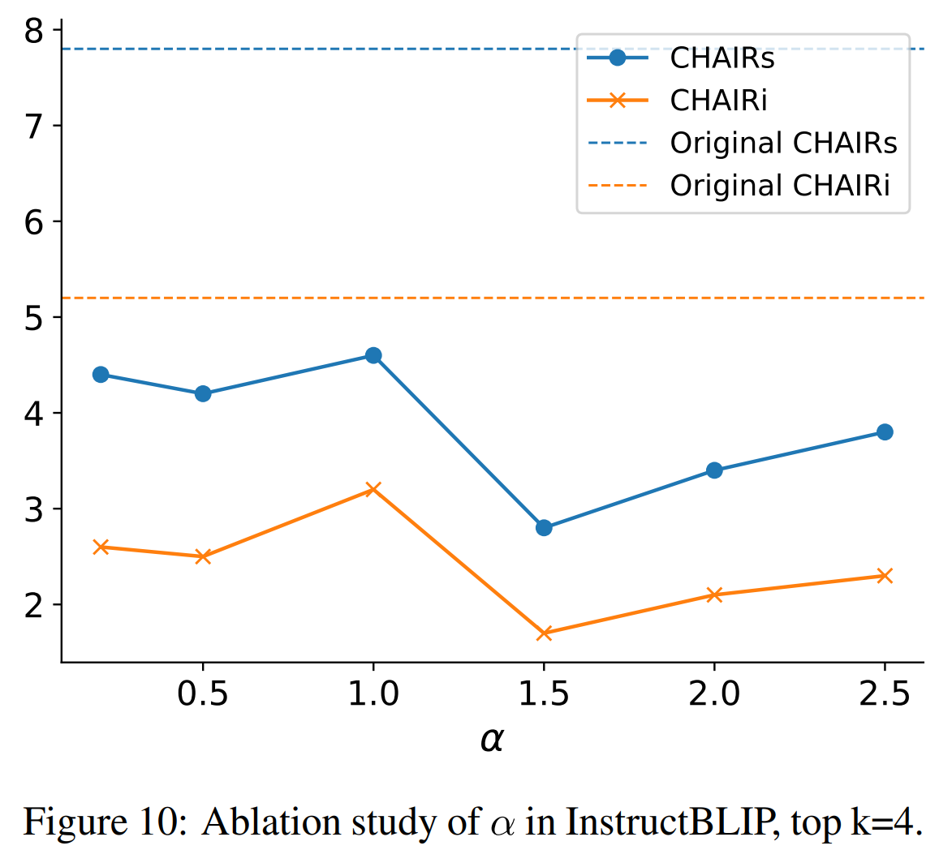
Ablation Study
Ablation Study
Amplification Factor

Slide 19

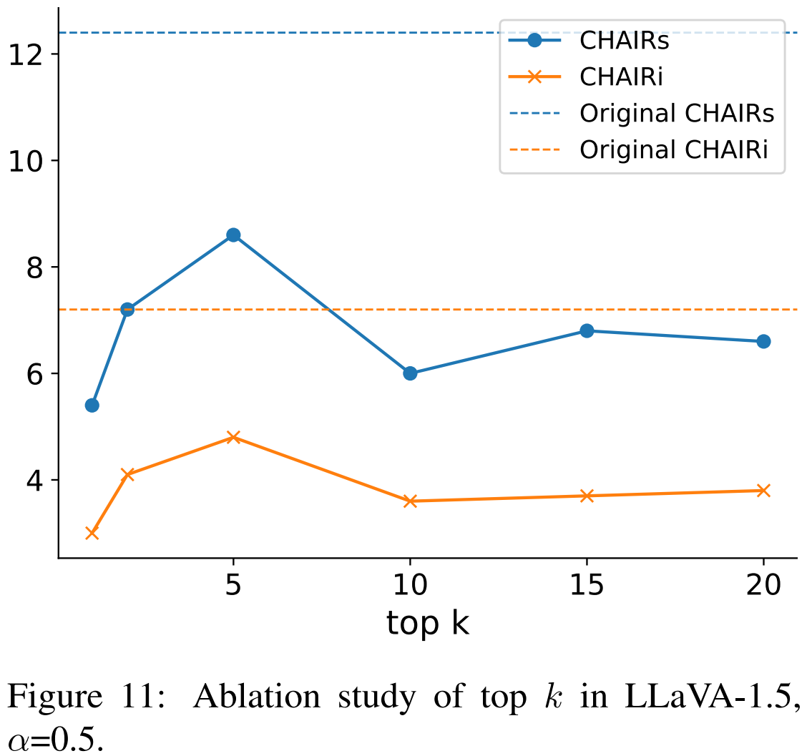
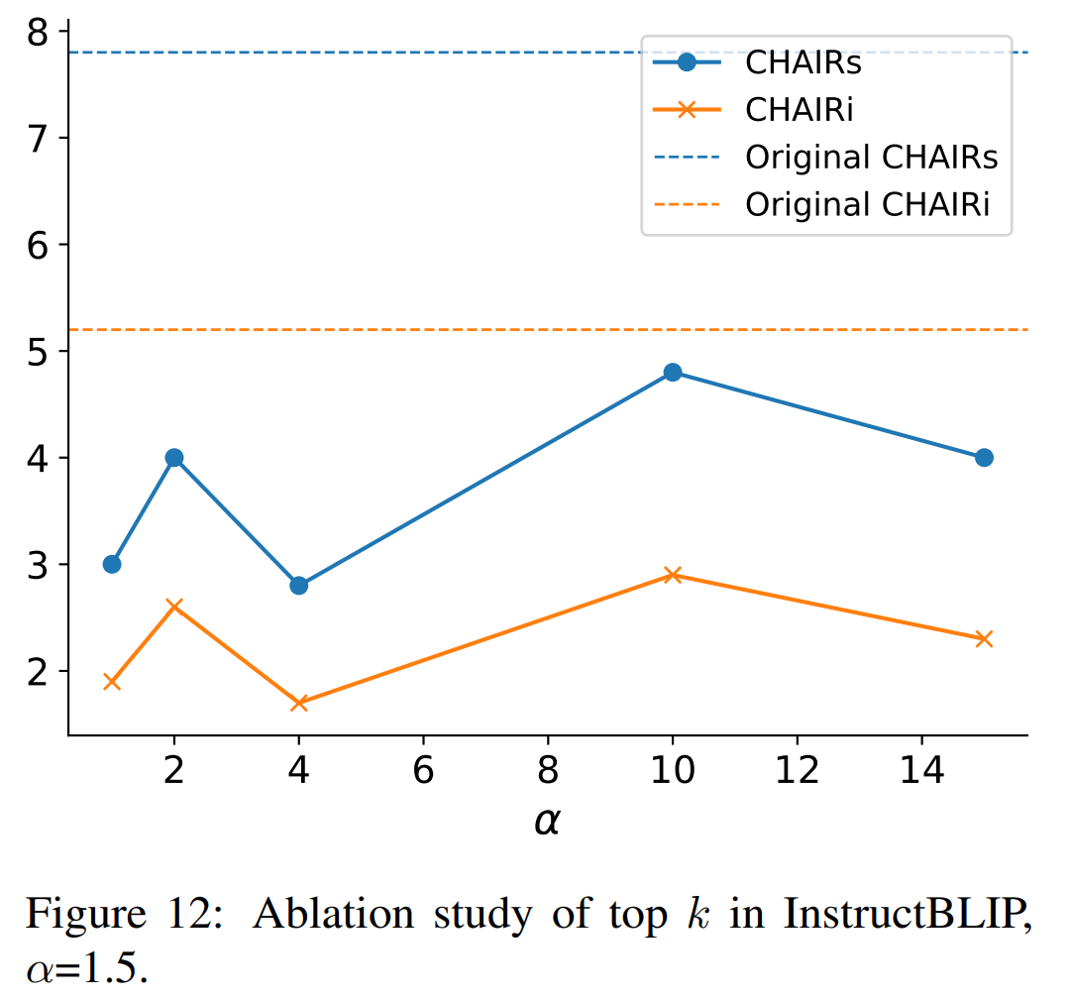
Ablation Study
Ablation Study
Outlier Token Number top

Slide 20
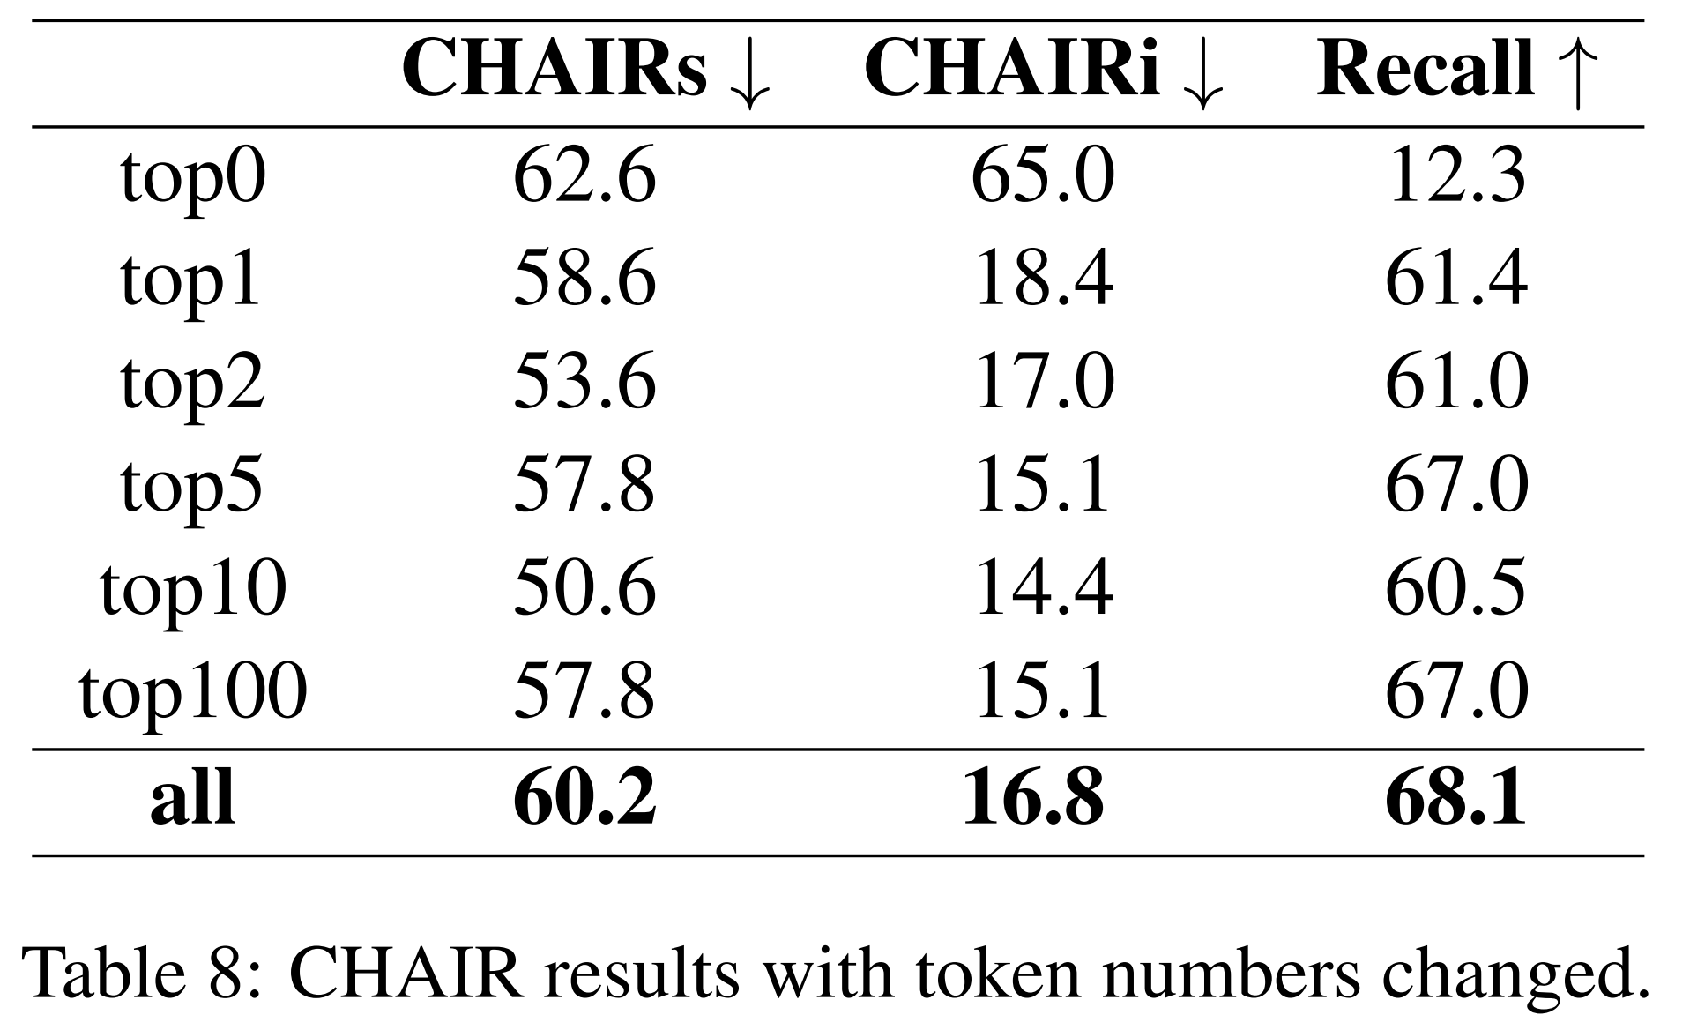
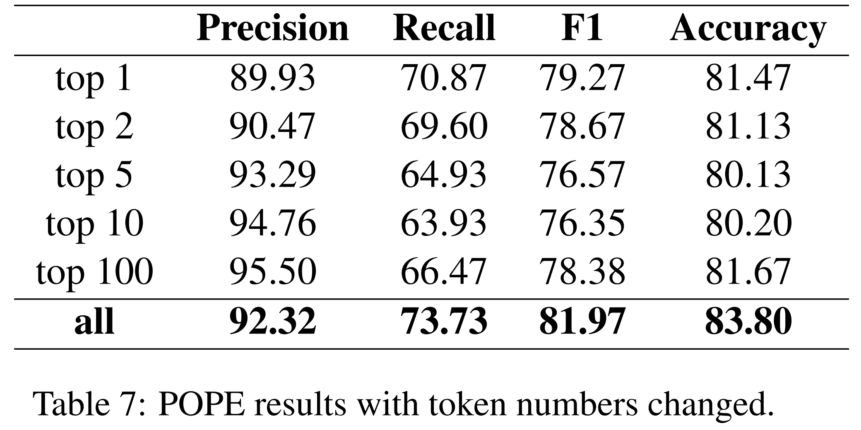
Ablation Study
Ablation Study
How Many Visual Tokens are Enough?

Slide 21
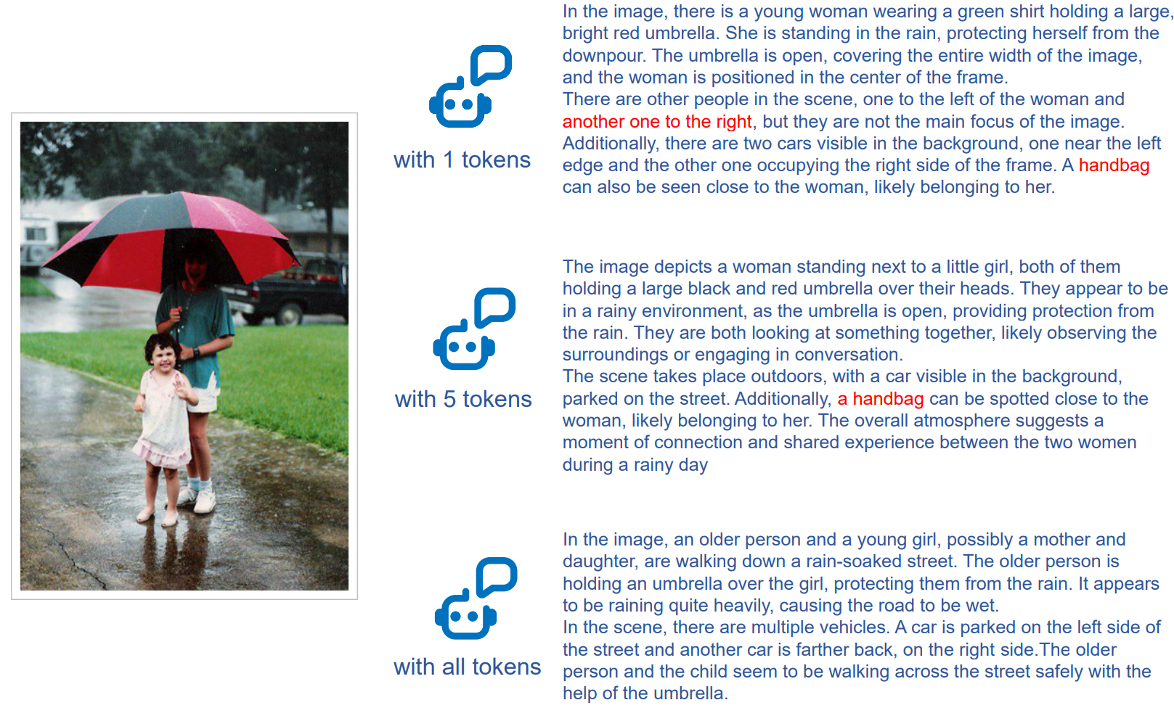
Ablation Study

Slide 22
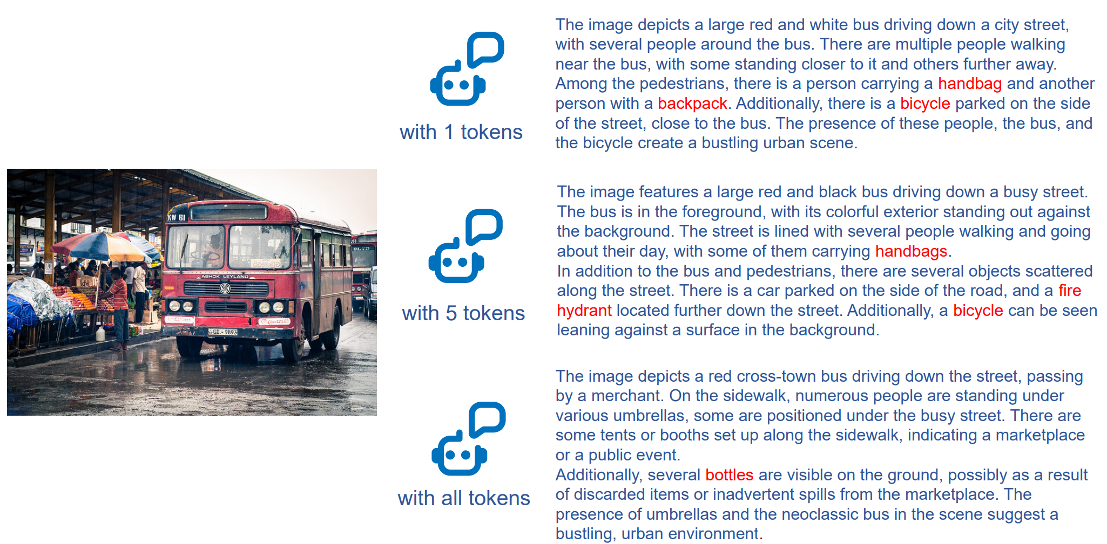
Ablation Study

Slide 23
Thanks for your Attention
2024-04-25

